Slide 1
Parent/ Carer Introduction to Phonics and Early Reading
2023

Slide 2
Welcome!
What is phonics?
Blending
Common exception words
Reading and books
Reading at home
Reading strategies
How to help?
Phonics screening check
Questions and next steps
Notes:
Welcome parents to the session.
We are very excited they are here to learn about the most amazing journey that their children are starting – learning to read!!!
Explain how you are structuring the session/ sessions to give them information about how early reading is taught at your school and how they can play a vital role in supporting their child’s reading journey.

Slide 3
We love reading!
Reading for pleasure
Finding out information
Reading the world around them
Understanding forms and official documents
Accessing learning
Notes:
Reading is one of the most important things we can teach our children. We want all our children to be avid readers with a love for all different types of literature.
Think of reading activities you do everyday…. (ask parents to contribute or have a list to share!)
As children start their school life they will very much focus on learning to read. As they move higher up the school and intro secondary education and beyond they will be reading to learn. So it is vitally important that we support our youngest pupils to quickly learn to read. We want every child to love reading and to do this we must make sure that it is a pleasurable experience and that they can read with accuracy and fluency so they can access as many opportunities as possible.

Slide 4
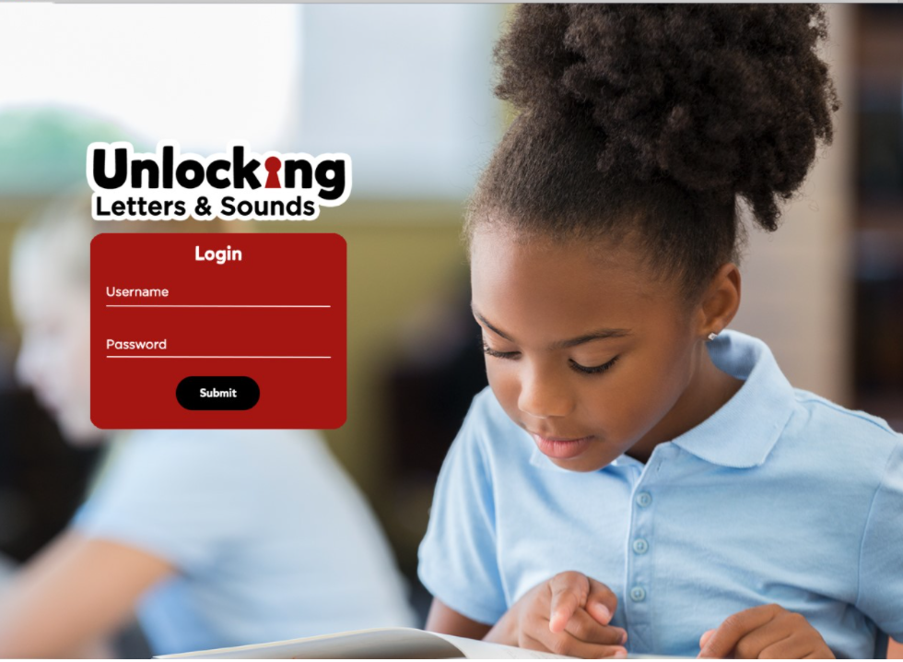

What is Phonics?
Link between the words we say and the letters that represent each sound.
Grapheme – the written letter or groups of letters
Phoneme – the sounds that the grapheme makes.
Notes:
Over the past 50 years schools have taught children to read using lots of different approaches. But, thanks to research we know that phonics is the best way to teach children to read. We know this might be different to how you were taught to read so we hope this session/ sessions helps you to understand what phonics is, how we will teach phonics at our school and how you can help your child to learn to read.
The national curriculum says that phonics should be the main way that schools teach children to read. The Department of education have recently approved phonics schemes that meet it’s criteria of a good scheme. Our school has chosen to use a scheme called Unlocking Letters and Sounds. All schemes are slightly differently but , as a school , we think this is the best one for our pupils. All children in the school will use Unlocking Letters and Sounds to teach their phonics and early reading. All staff have had training with this scheme so they are experts at using it.
Phonics teaches the link between the words we read/ say and he words we write on the page. It teaches how the letters in written words represent the sounds we say in spoken words – this is called decoding.
Sat the word CAT.
When we say this word we say lots of sounds very quickly – so quickly we hardly notice the sound each letter makes.
Say the sounds in CAT c/a/t
What sounds can we hear? When we write the word cat we represent each sound with a symbol that we call a letter. C A T
This is phonics!
There is some technical vocabulary that we use for phonics and that your children will use.
Grapheme – the written letter or groups of letters
Phoneme – the sounds that the grapheme makes.
With your new vocabulary can you tell me the phonemes that make this word (map)
Can you tell me the graphemes that represent these phonemes?

Slide 5
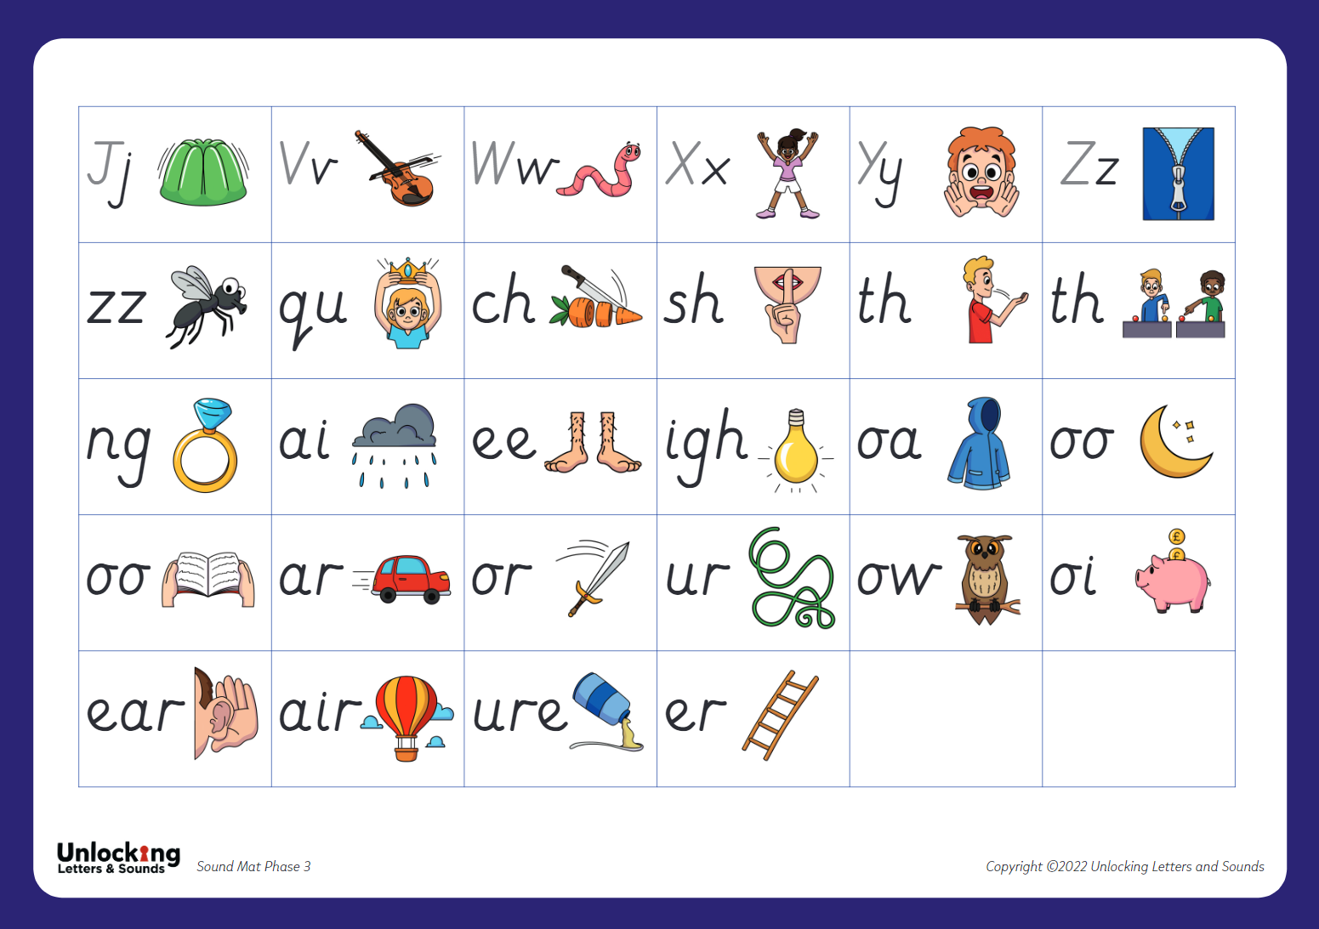
What is Phonics?
Notes:
As children start to learn their grapheme phoneme correspondences (GPCs) it is very important that we pronounce the sounds clearly and purely. We also help them to learn and remember the GPCs in Reception with an image and action for each phoneme. Your children will be coming home sharing the actions with you so do join them when they are using them!
Model pronunciation and actions for some of the first GPCs children will be learning.

Slide 6
Blending
Pushing the phonemes together to make a word.
Oral blending: An adult sounding out words, the child identifies what the adult is sounding out.
Notes:
As well as learning to recognise the graphemes and say the phonemes they represent we will be teaching children how to use these to read.
When we read a word we look at each graphemes and match a sound to it. We push the sounds together to make a word. This is called BLENDING.
Blending is a really important skills that children need lots of practice at – it will take lots of time!
Let’s have a go at blending a word: t / r / ee
We teach the children to work from left to right - identifying each grapheme and saying the phoneme. Once they have done that they go back and push the phonemes together to blend the phonemes together to read the word.
We want to teach children to recognise the grapheme quickly so they can blend it rapidly. Once they can do this their reading will become fluent – and less painful! But this really does take a he amount of practise so it is really important that children practise this at home with the books we give them.
As children progress in their reading journey they will begin to read longer words made up of multiple syllables – give the example of fun – funny – funniest
We teach these words by ‘chunking’ them into syllables and blending these chunks together. But we are still identifying the GPCs and blending them together.
This is what we will do as adults when we come across an unfamiliar word – use the example crepuscular. How would we read this unfamiliar word? We would chunk it and blend the syllables together. This is why it’s really important to teach children to read using phonics – without this skills to decode the graphemes we would not be able to read unfamiliar words.

Slide 7
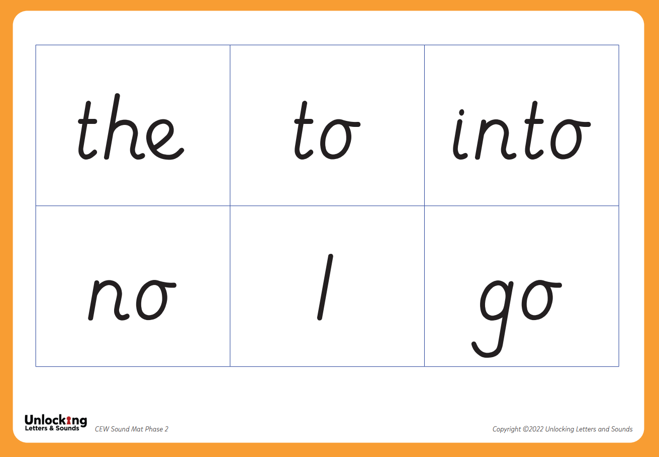
Common Exception Words
Notes:
There are some words that we use a lot in English such as the, like, said, were.
To give children’s reading a boost and so they can access more tests quickly we want children to learn these CEWs early on. Many of them have usual patterns or GPCs that aren’t taught until later on. So we teach children to recognise them by sight initially. Children will be able to decode some of them later on but , until they have learnt to decode them, we recognise them as CEWs.

Slide 8

Reading at home
5 – 10 minutes
Choose a time that works for you
Be positive and celebrate successes
Encourage them to point to the graphemes
Encourage them to say the sounds and blend them together
Be patient and let them try and work it out
Read common exception words by sight.
Notes:
Reading at home is essential as it gives children the opportunity to practice their decoding and blending skills.
We know everyone is busy and children often don’t want to read out of schools. Our top tips are:
5 – 10 minutes every day is often more effective than longer times
Find a time that works for you. Reading at bed time sounds lovely but with a tired child it can often be tricky!
Celebrate what your child can do and
Encourage your child to point at the graphemes as they read – this helps them to track the words and know their place
Encourage them t o say all the sounds in the words and then blend them together – you can show them how to do this.
Be patient and give them time to work it out before stepping in before stepping in If they can’t read a word model how to do it and then ask them to do it.
Let them read common exception words by sight.
One of the most important ways to increase children’s accuracy, fluency and understanding of the book they are reading is to re-read the same books several times. This is why we only give XX number of books each week – we would like each book to be read at least three times with a different focus each time.
This films explains the value of re- reading the same book and what you should focus on each time. https://www.youtube.com/watch?v=Hhu3xeNq3Kg&t=200s

Slide 9
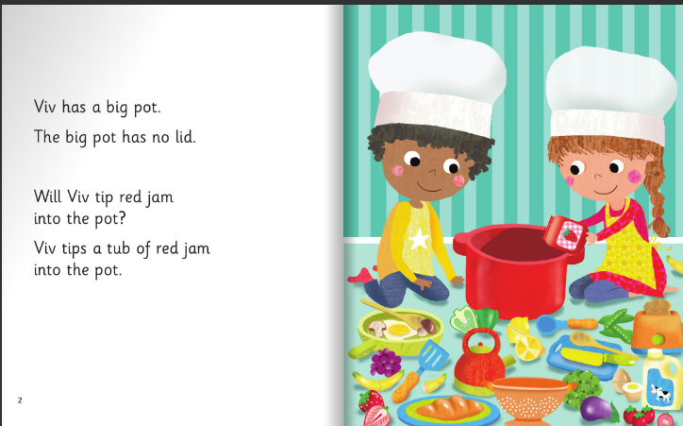
Reading strategies

Slide 10
Reading at home
Continue to read to your child.
Model how to read a book – left to right, turning pages
Ask questions about what has happened and characters’ feelings
Support vocabulary
Predict what will happen next
Make connections
Model your love of reading!
Visit your local library.
Notes:
Whilst learning to decode and reading books that allow children to do this is important there is so much more to reading! We know that decodable books are not the most exciting to read and alone, won’t give our early readers all the skills they need to develop a love of reading.
It is therefore important that you continue to read to your child and share a wide range of books with them – these should be books that children cannot decode themselves. Reading books to children is a precious and lovely thing to do – we are sure you and your child already have favourite books that you share together! By modelling reading and show how much you love reading you will be setting a fantastic example to your child.
When you read to your child you will want to:
Model how to read a book
Ask questions about what has happened to support your child’s comprehension or understanding of the text
Ask questions about characters’ feelings
Discuss the meaning of words and vocabulary
Ask children to predict what they think will happen next
Make connections with things your child has experienced or other books or films they have seen
Most importantly – show that you love reading! By modelling this you will support your child to develop their love of reading.

Slide 11
How to help
Please ensure your child has had a recent eye test.
Reading books and reading records should be in school every day.
Children should re-read books to develop their fluency and speed. We will change books on a Friday or when your child has read their book 3 times.
An after school club is being run on Thursdays to offer additional reading support to children.
Notes:
As soon as your child can blend some GPCs together to read words we will be giving them a book. This is incredibly exciting but will be different for every child. Some learn this skills very quickly and others take a bit longer – we will be supporting every child to blend as quickly as possible. Please don’t compare your child with others and contact us if you are worried about anything.
Once your child can read they will be given a book that precisely matches their phonics attainment so that they can read at least 95% of the words in it. Please don’t think that this makes the book too easy for them – it’s vitally important that reading is a celebration of children’s reading with you and a chance for them to show their phonics expertise.
In school we will also be reading with children. They will read everyday in their phonics lessons and also every week/ day/ 3 times a week in a guided group. This is when they read with their teacher in a small group. The teacher will listen to every child read as well as teaching for part of the session. This allows us to check every child’s learning.
We will listen to children read on a 1:1 basis once a fortnight/ term/
Books are allocated to match the sets and phases that children are secure in. When teachers assess they are ready to move onto the next set we wil do so but we know that this takes a different amount of time for each child – some will need more practice than others.

Slide 12
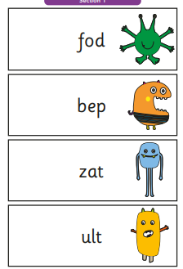
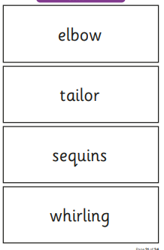
Phonics screening check
At the end of Year 1 (June 2024), children will complete a reading test. They need to blend and read 40 different words. 20 are real words and 20 are ‘alien’ words. An alien word is a word that needs to be sounded out as it isn’t a real word.
Children need to score 32/40 to pass.
Notes:
Learning to read is such an exciting journey for children and we are incredibly excited to be starting it with your child. We hope today’s session has given you an understanding of how we teach phonics at our school.
Ask for questions
Give information about next steps specific to your school eg. more workshops, coming in to read with their child etc.

Slide 13
Questions?
Thank you all for attending!

