Slide 1
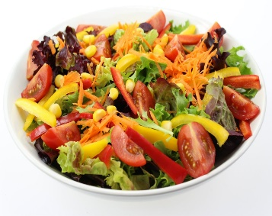
WHITCHURCH SCHOOL CATERING September 2021
Dates | Monday | Tuesday | Wednesday | Thursday | Friday
Week 1 06/09/2021 20/09/2021 04/10/2021 18/10/2021 08/11/2021 22/11/2021 06/12/2021 | Jacket Potato with Cheese, Beans, Tuna and coleslaw. * Lemon Sponge | Chicken or Quorn Nuggets Herby Diced potato Sweetcorn * Angel Delight | Roast Turkey, Roast Potatoes, Stuffing, Carrots, Cabbage and Gravy * Cake of the day | Pasta Bolognaise with Garlic Bread broccoli * Pancakes | Fish and Chips or Salmon Nuggets Baked beans peas * Fresh Fruit & Ice Cream
Week 2 13/09/2021 27/09/2021 11/10/2021 01/11/2021 15/11/2021 29/11/2021 13/12/2021 | Margherita Pizza with Wedges Salad Coleslaw sweetcorn * Shortbread | Chicken or Quorn Curry and Rice Naan Bread Broccoli * Jelly | Roast Turkey, Roast Potatoes, Stuffing, Carrots, Cabbage and Gravy * Mixed Fruit crumble & custard | Chicken or Quorn fillet in a bun with Salad & coleslaw Potato wedges * Cake of the day | Fish and Chips or Salmon Nuggets Baked beans peas * Fresh Fruit & Ice Cream
Available daily freshly baked bread, salads, fresh fruit, natural yoghurt, fruit yoghurt and milk

